Slide 1

Boolean Logic and Logic Gates
Presented By:
Elizer Ponio Jr. Department of Computer Science
College of Computing and Information Technologies

Slide 2
Outline
Recap of Binary Representation
Transistors
Boolean Algebra
Logic Gates

Slide 3
Recap: Binary Representation
Modern computers are electronic devices filled with a lot of tiny wires and circuits.
These wires and circuits carry electricity and at any moment they can be ON or OFF.
And that information that is represented using the two states of electricity is called a binary system

Slide 4
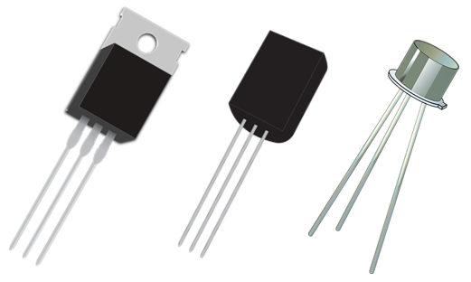


Transistors
Computers have semiconductor devices called transistors that can turn the flow of electricity ON or OFF
Your phone has hundreds or thousands of transistors in it.
Your computer has millions or even billions of transistors inside!

Slide 5
Transistors
Think of transistors as tiny electronic switches that can be turned ON or OFF
When it is turned ON, it allows the flow electricity
When it is turned OFF, it stops the flow electricity.

Slide 6
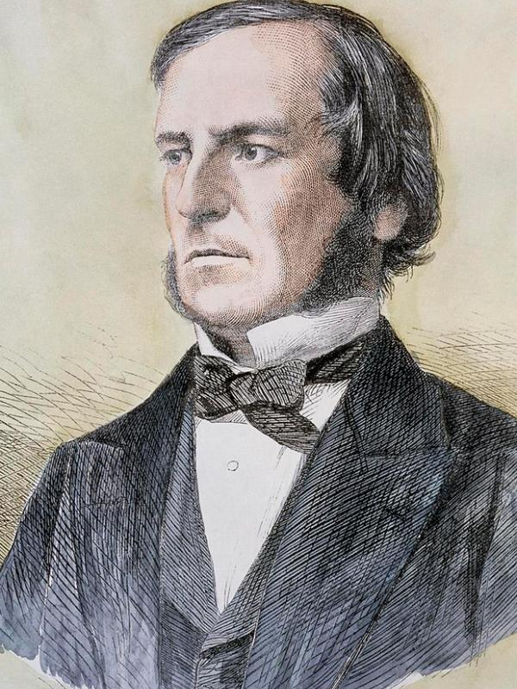
Boolean Algebra
There is a reason why computers use the binary system.
An entire branch of mathematics that dealt exclusively with TRUE or FALSE values had already existed and had all the necessary rules and operations for manipulating them.
It’s called Boolean Algebra!
The rules of this system were formulated by George Boole

Slide 7
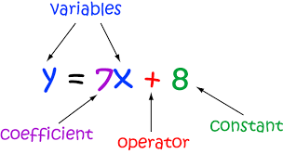
Algebra vs Boolean Algebra
In “regular” algebra, the values of variables are numbers and operations on those numbers are addition and multiplication

Slide 8
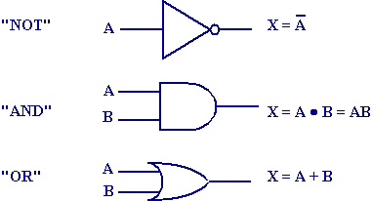
Algebra vs Boolean Algebra
In boolean algebra, the values of variables are TRUE and FALSE and the operations are logical

Slide 9
Boolean Algebra
There are three fundamental operations of in Boolean Algebra
AND
OR
NOT

Slide 10
NOT Operator
The simplest gate is the NOT gate, also known as an inverter.
It accepts a single input and outputs the opposite value.
One way to understand Boolean operations is to make a truth table of all the possible inputs and outputs. Here's a truth table for the NOT gate:
Input | Output
TRUE | FALSE
FALSE | TRUE

Slide 11
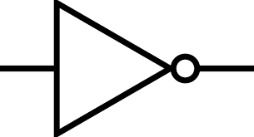
NOT Gate
We can build Boolean Logic out of transistors!
A NOT logic gate is represented by

Slide 12
AND Operator
The AND operator accepts two inputs and returns one output
If both inputs are TRUE it outputs TRUE
If both inputs are FALSE it outputs FALSE
Input A | Input B | Output
TRUE | TRUE | TRUE
TRUE | FALSE | FALSE
FALSE | TRUE | FALSE
FALSE | FALSE | FALSE

Slide 13
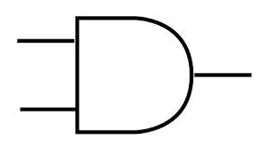
AND Gate
An AND logic gate is represented by

Slide 14
OR Operator
The OR logic gate accepts two inputs and as long as either of those inputs is a TRUE, it outputs TRUE
Input A | Input B | Output
TRUE | TRUE | TRUE
TRUE | FALSE | TRUE
FALSE | TRUE | TRUE
FALSE | FALSE | FALSE

Slide 15
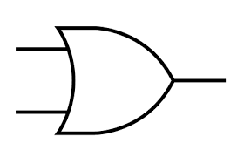
OR Gate
An OR logic gate is represented by

